Slide 1
Prevalence and Predictors of Client-Initiated Violence among Zambian Female Sex Workers
Kalonde Malama¹, Bruno Spire¹, Andréa Gosset¹, Marie Nishimwe¹, Pierre-Julien Coulaud¹, Luis Sagaon-Teyssler¹, Rachel Parker², Amanda Tichacek², Mubiana Inambao³, William Kilembe⁴, Susan Allen²
¹ Aix Marseille Univ, INSERM, IRD, SESSTIM, Sciences Economiques & Sociales de la Santé & Traitement de l’Information Médicale, Marseille, France, ²Rwanda Zambia HIV Research Group, Atlanta, GA, United States, ³Zambia Emory HIV Research Project, Ndola, Zambia, ⁴Zambia Emory HIV Research Project, Lusaka, Zambia
Conflicts of Interest
The authors of this presentation have no conflicts of interest to declare
Abstract no:TUPDD0103

Slide 2
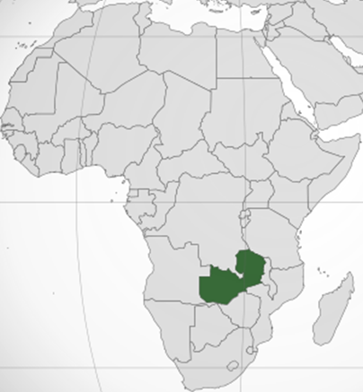
Context
HIV prevalence:
General population11.5%¹
Female sex workers (FSW) 56%²
Gender-based violence (GBV) prevalence 43%³
Sex work illegal
Increased risk of violence from male clients
Mental and reproductive health consequences
Objective: determine if sexual environment, sexual history and risk behaviours predict violence
Violence
Client less likely to use condom⁴
FSW less able to negotiate condom use⁴

Slide 3
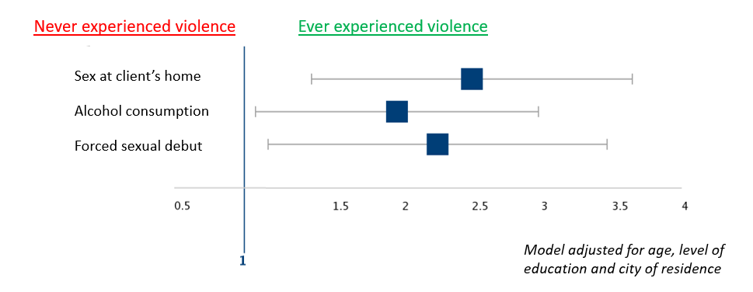
Results
Prevalence of client-initiated violence=39%
Predictors of violence:
Having sex at client’s home (adjusted odds ratio (AOR) 2.48; 95% confidence interval (CI) 1.48-3.77)
Consumption of alcohol (AOR 1.83; 95%CI 1.08-3.1)
Physically forced sexual debut (AOR 2.04; 95%CI 1,17-3.59)
Multiple logistic regression model, n=419

Slide 4
Conclusions
Sexual environment, sexual history and alcohol consumption important predictors
Risk reduction counselling for FSW:
dangers of sex in client’s home
vulnerability imposed by alcohol
Life course interventions:
protect adolescent girls from physical/sexual abuse
HIV prevention interventions should include GBV component

Slide 5
References
UNAIDS, 2017. Country factsheets, Zambia. [online] Available at: http://www.unaids.org/en/regionscountries/countries/zambia
FHI360 & TDRC, 2016. Integrated biological and behavioural surveillance survey (IBBSS) among female sex workers and male long distance truck drivers in five corridors of hope project district sites in Zambia, 2015. [online] Available at: http://www.nac.org.zm/sites/default/files/publications/IBBS%202015%20Final%20Report%204%20March%202016.pdf
Central Statistical Office (CSO) [Zambia], Ministry of Health (MOH) [Zambia], and ICF International. Zambia Demographic Health Survey 2013-2014. Rockville, Maryland, USA: Central Statistical Office
Schwitters A, Swaminathan M, Serwadda D, et al. Prevalence of Rape and Client-Initiated Gender-Based Violence Among Female Sex Workers: Kampala, Uganda, 2012. AIDS Behav. 2015;19(0 1):S68-S76. doi:10.1007/s10461-014-0957-y
Contact
Kalonde Malama
Aix-Marseille University
Sciences Economiques & Sociales de la Santé & Traitement de l’Information Médicale
Email: kalonde.malama@univ-amu.fr

